Slide 1
Book Day 2021

Slide 2
Students from 2MB, 3MB & 4MA along with teacher Madelaine, wrote some anecdotes related to books they have read!
Funny? Sad? Interesting?
Judge yourself!!!

Slide 3
Maria Paz Sepúlveda 4MA
01
03
02
Once, a friend asked for a book that she had lent me but
I was sure that I had returned it.
But… it was on my nightstand! I felt very ashamed.
We fought because I was sure that I had given it back.

Slide 4
“The Goldfish Boy“
01
02
When I was younger I read "the goldfish boy“. This book tells about a boy with OCD and it had a lot of information about diseases and bacteria in the environment.
I was so scared about touching things and getting a disease that I didn't want to go out of my house.
Sofía Carvajal 3MB

Slide 5
La Selección by Kiera Cass
I remember that I was desperate to buy a book. Every day I told my sister to buy it for me and when she finally did it, I finished it in less than a day. It was beautiful!
VALENTINA VILLAGRAN MORA
4MA

Slide 6
Joaquin Salinas 2mB
In my previous school, I read a book of mystery and horror. I can´t remember the title and the author but the narrator was Frankenstein.
That book was so good! It is the only one -in all of my life- that I could truly enjoy and not for obligation or duty like the other books that I must read.

Slide 7
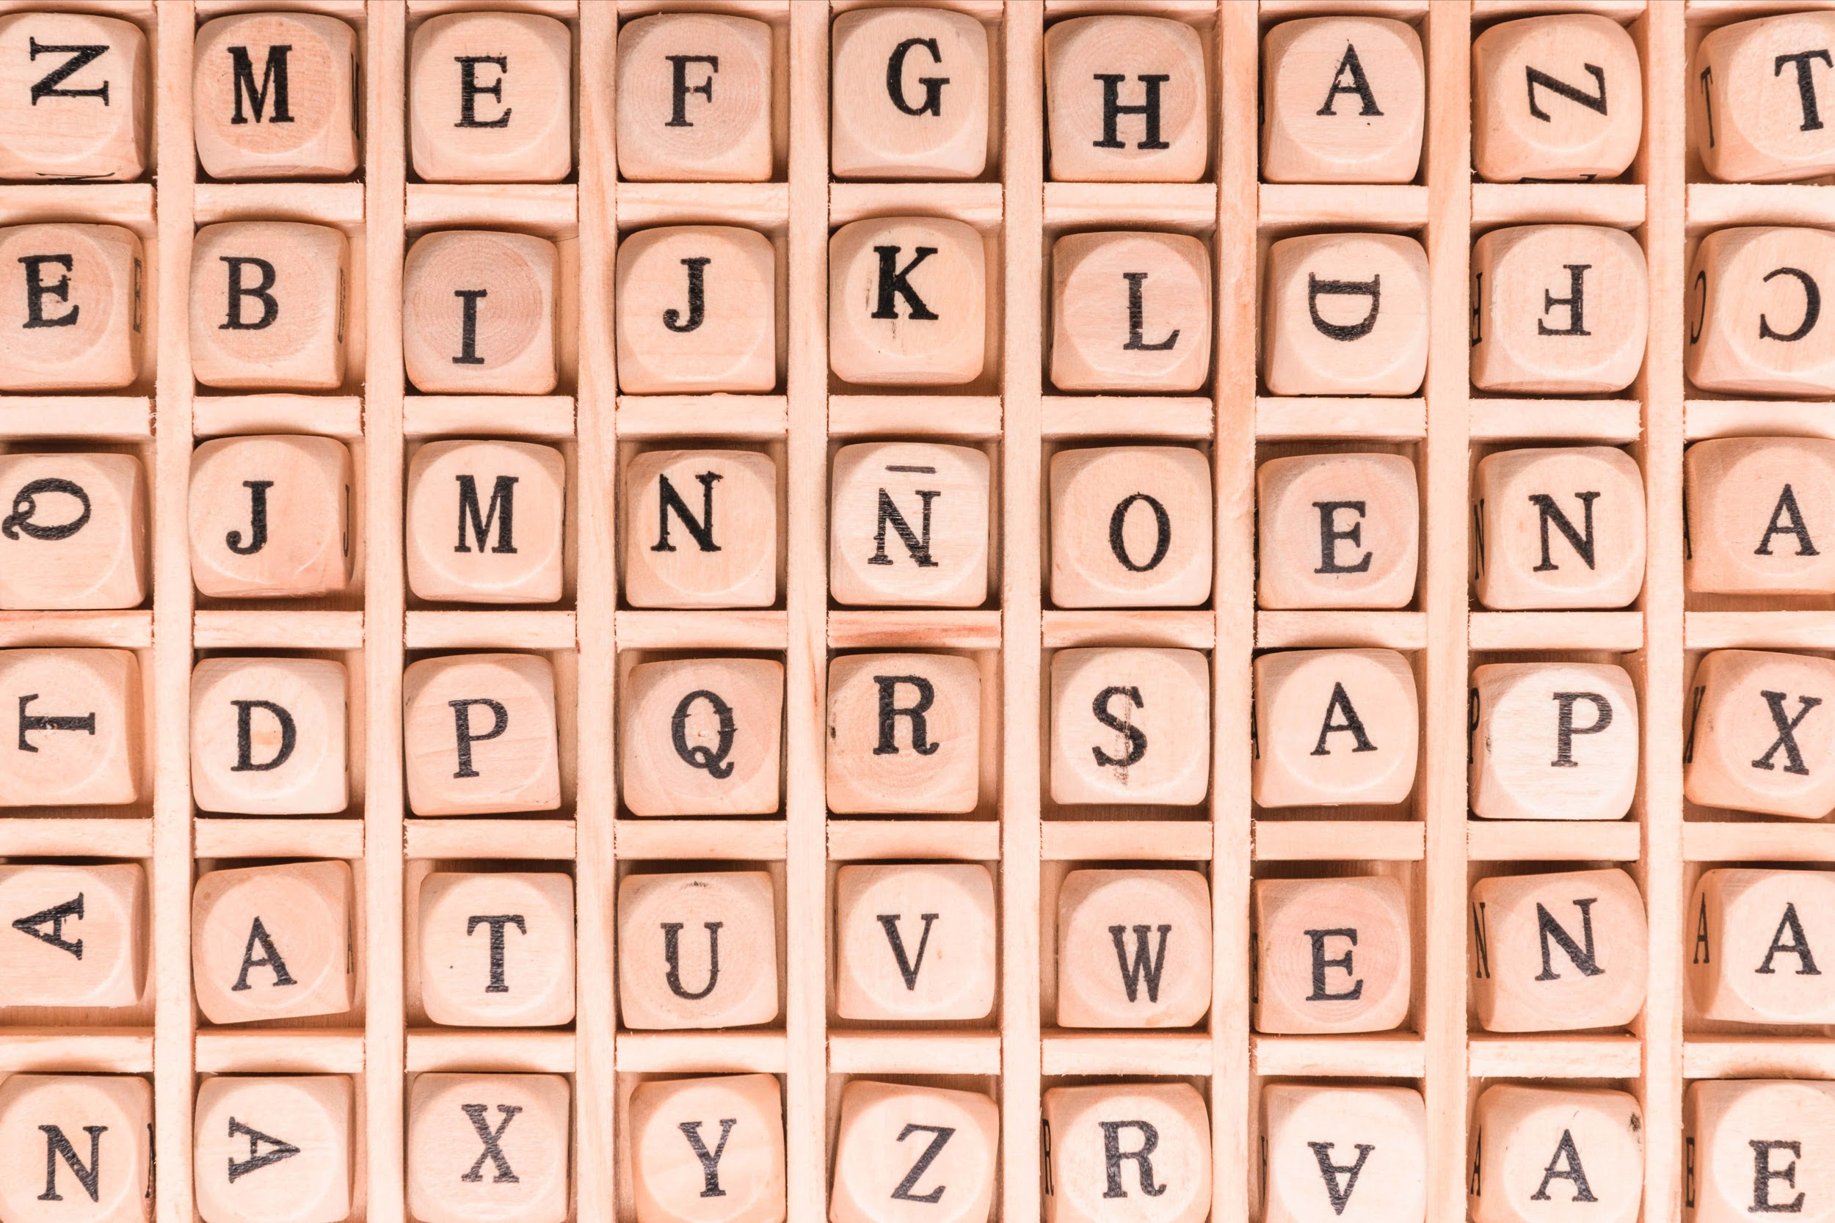
Martin Rivas By Alberto Blest Gana
When I read this book, I found it so boring that when I was in the chapter 2,
I fell asleep.
And that had never happened in my life with a book!!
ESTEBAN OÑATE HERRERA
4MA

Slide 8
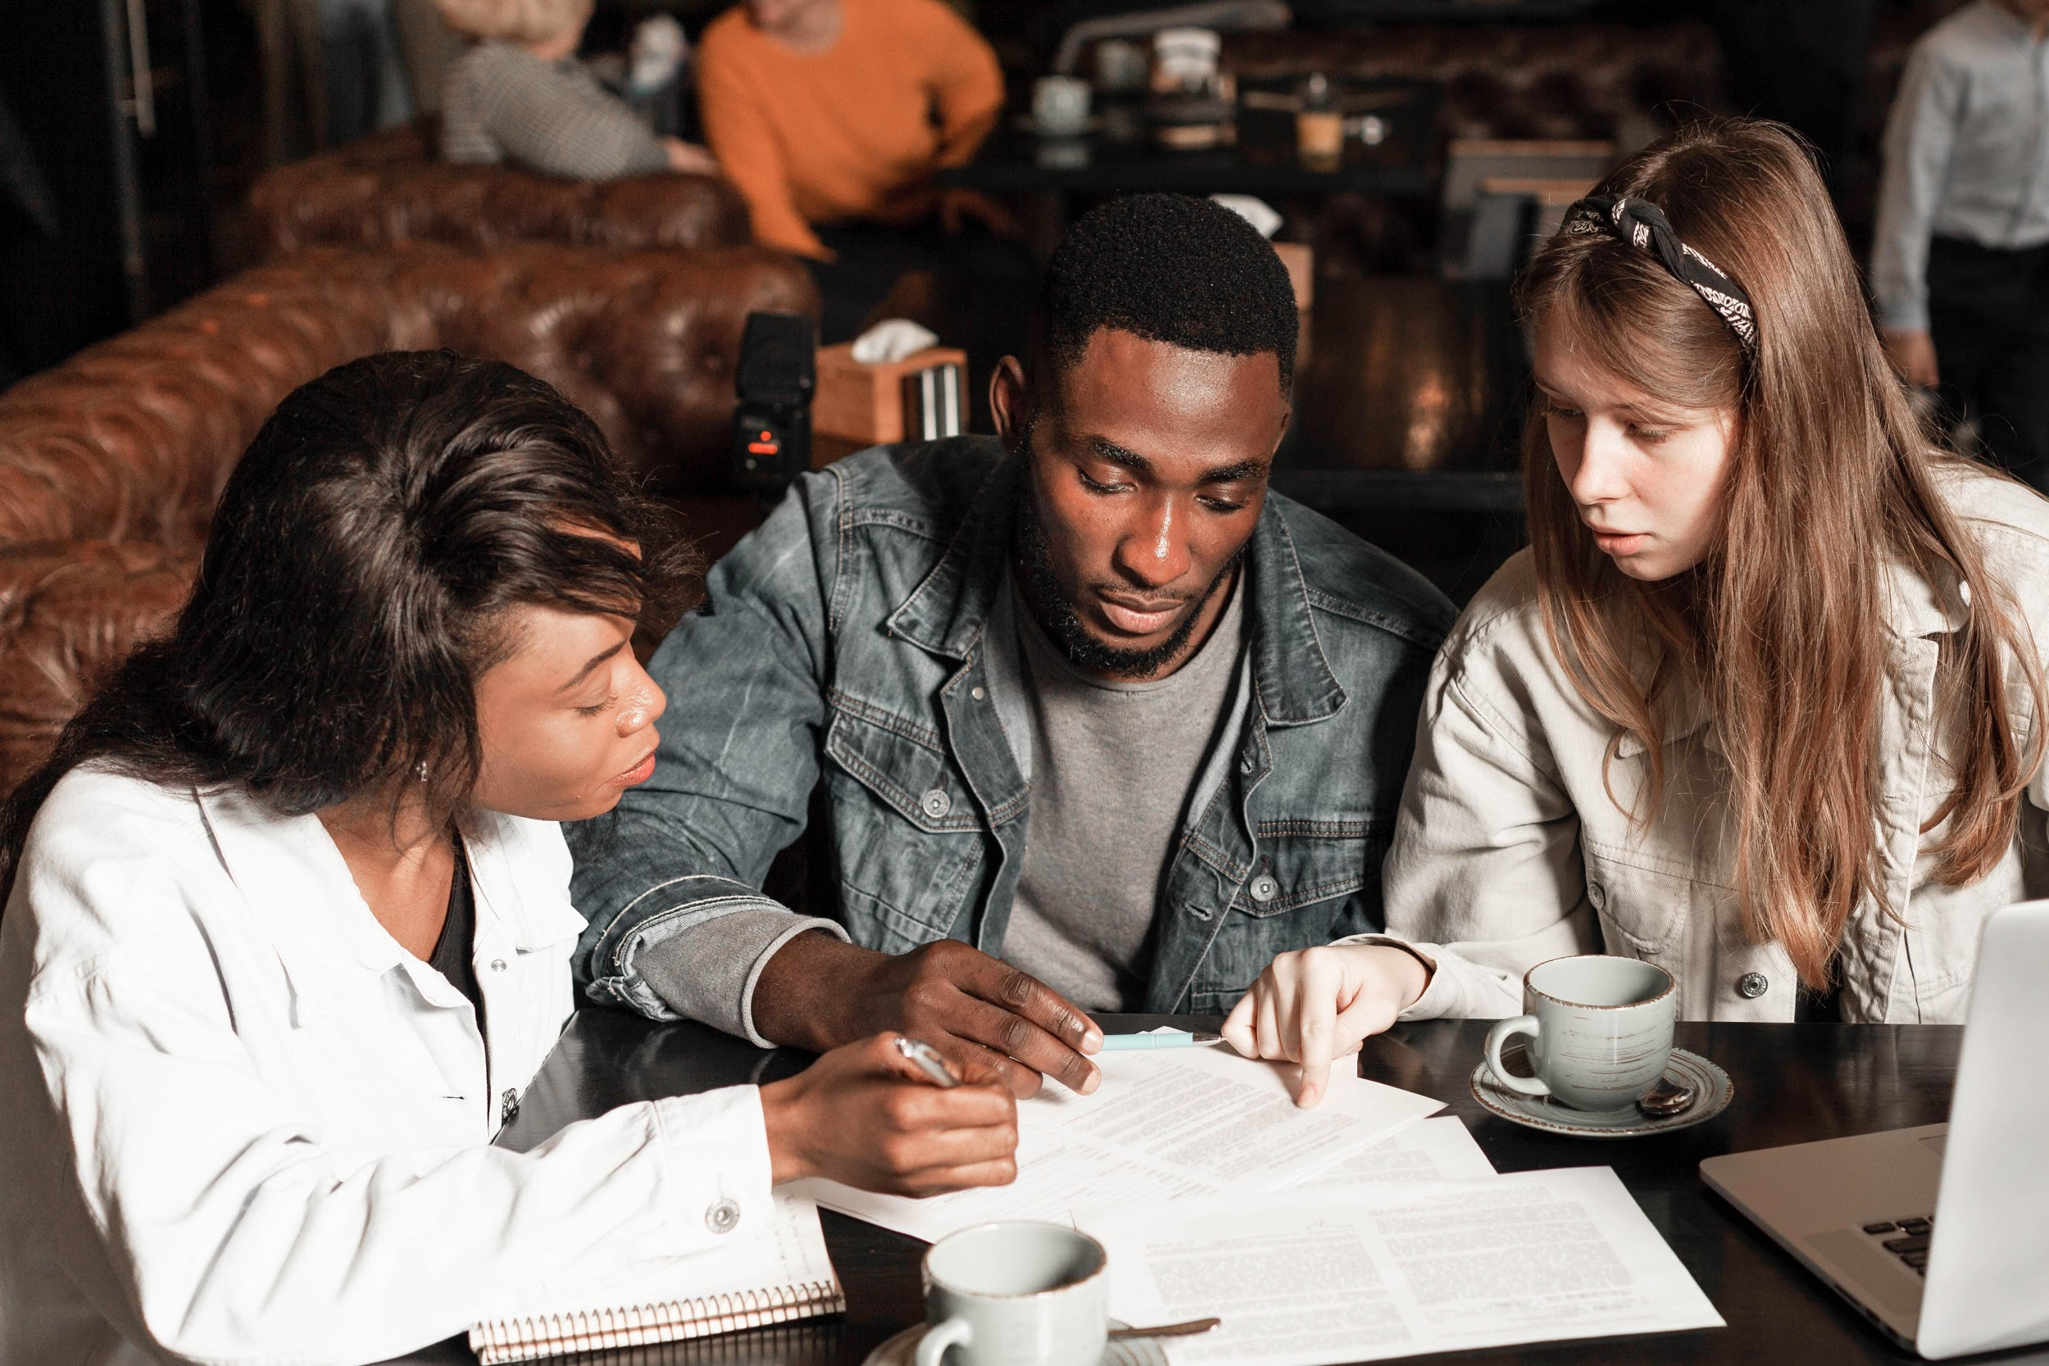
Momo
When I read this book, this was the phrase that made me change my way of thinking about fantasy and dreams: <<Fantasy is not a way to escape reallity, but a more pleasant way to get closer to it” - Michael Ende.
Paulina Cortés 3mB

Slide 9
Martin Rivas - Alberto Blest Gana
2 Years ago, I had to read the book for the test but I didn’t. Every time I read the book I fell asleep.
I couldn’t finish even one page of the book and I fell asleep!
When the day of the test arrived, I only read the first quarter of the book, a middle chapter and one of the final chapters.
Everyone, I think, read almost the whole book. They got marks between 6,0 and 6,5. About me, who only read small parts of the book, got a 6,7.
My 6,7 was the best mark of all the grade. It was astounding!!
Thomas Gómez 4° Senior

Slide 10
Martín Rivas By Alberto Blest Gana
When we had to read this 300-page-long book, not many people was interested in it. Except me. I really loved the book!
I even read it twice before the test. But when the results came, I had a lower grade than my friend! And he had only read the summary…
Giuliana Gahona Aguayo
4MA

Slide 11
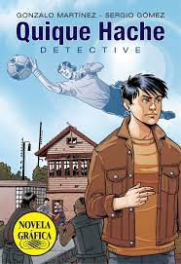
Quique Hache by Sergio Gomez
Day of the exam
I had to read a book at school for a test. My mom bought the comic version.
I read it in a day. At first, I didn’t want to read a book, but I really enjoyed reading it.
I got a 6,1 and I was happy for 2 things: first, because of the mark, and second because it was the first time I enjoyed reading
Matías Henríquez 2MB

Slide 12
The Lord of the Rings The Two Towers Written by J.R.R. Tolkien
What happened to me reading this book was that I had never read something without falling asleep.
But this book… I read it in two days because I liked it very much. This book has 352 pages!
Martin Chamorro
4°Grade A

Slide 13
Nostromo by Joseph Conrad
Day of the exam…
I was the only student who read the complete book. They all read the summary but “everyone” got great marks.
During university I was asked to read 500 pages of a (boring) novel in “old” English.
I committed to read it all because it was my duty as a student!
Teacher Madelaine

Slide 14
Fernanda Roca 2MB
Divergent by Veronica Roth
I read the book in a final fight. I was very excited so I screamed and my grandmother got scary for my reaction.
The Little Prince by Antoine de Saint-Exupery
I cried when I read this book. The part when the little prince goes to his planet is very sad part for me.
01
03
The Chronicles of Narnia the Prince Caspian by C.S. Lewis
All the time, I remember the sentences said by Aslan to Lucy. They stayed in my memory!
The Mansion by Anne Jacobs
With this book, I did not
sleep in one night. I just closed the door of my room and I finished this book.
Experiences with a book
02
04

Slide 15
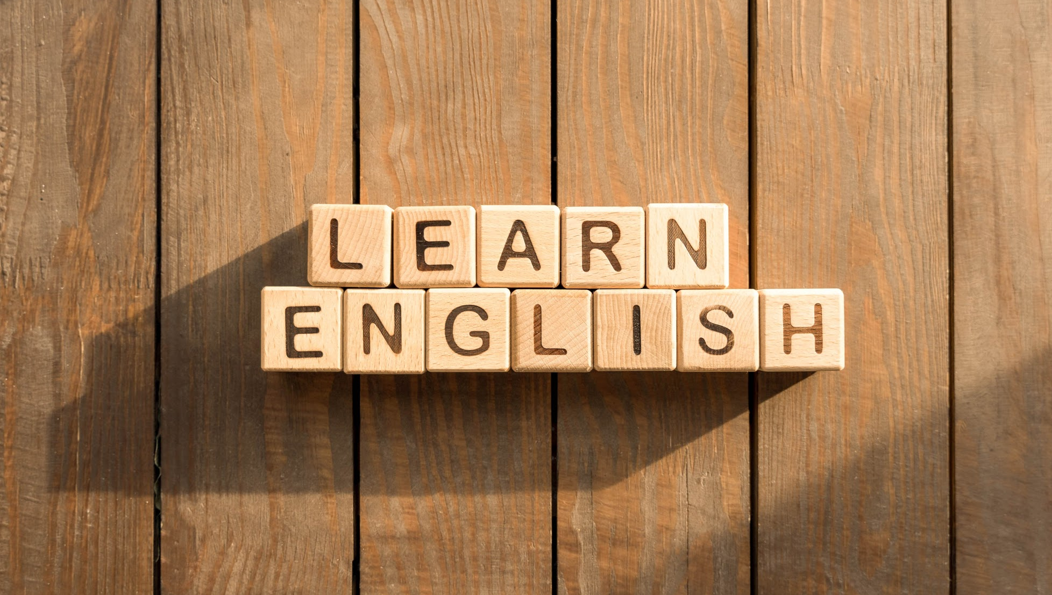
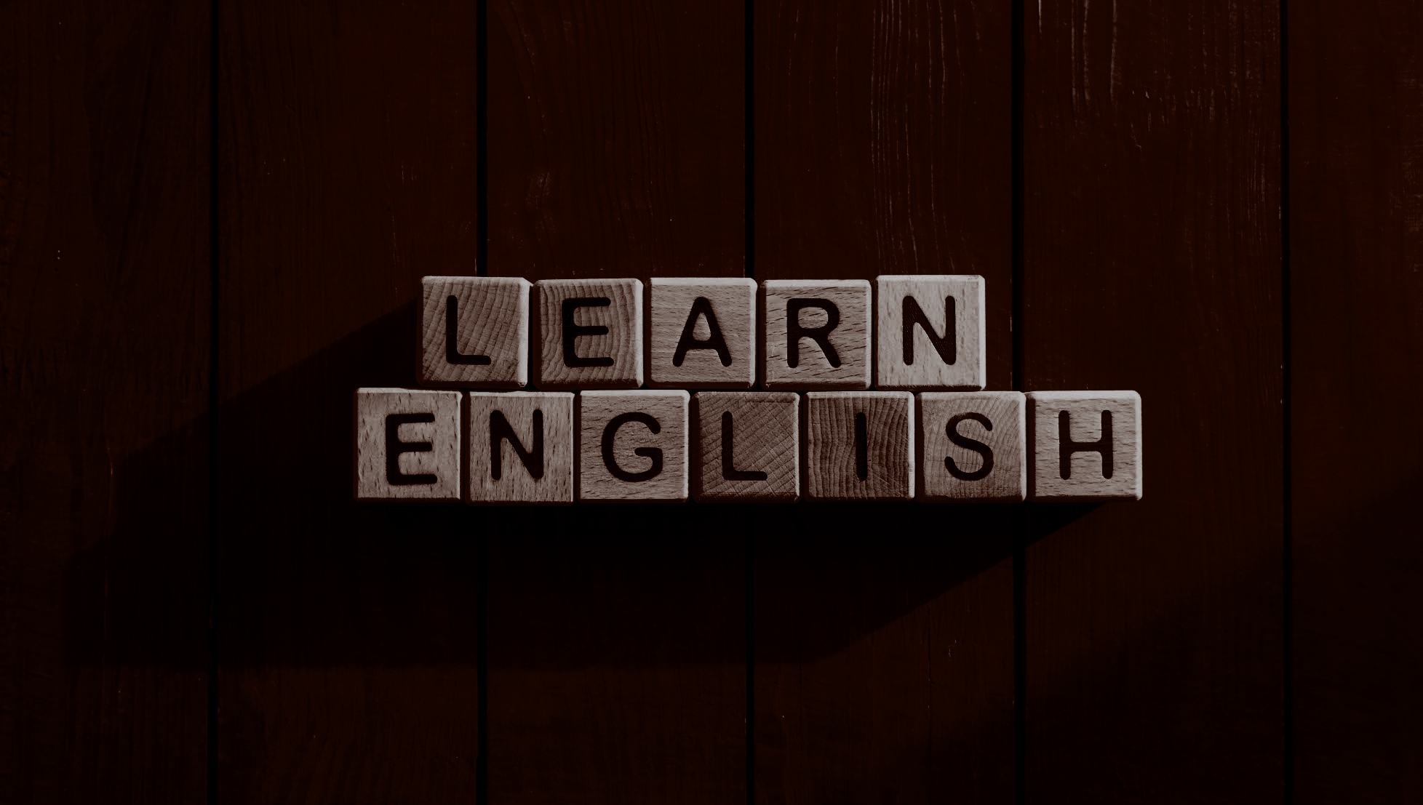
One day, I went to the bookstore and I saw a book that I liked but it was the 2nd part. I bought it and I thought: "the 1st part will be here in a while". About 3 years passed and I forgot the book… it never came. Good news? Recently, I bought the 1st part online.
Vicente Chandía 4th senior

Slide 16
—Andrea Rojas 3MB
The Origin Of The Species
by Charles Darwin
In biology, we had to read “The origin of the species”. For me, it was so boring that I thought it would be better to read and listen the audiobook. One day, I was lying on my bed while I was reading and listening the audiobook. After one hour, I realized that I slept more than half of what I had to read during that day.

Slide 17
Juego de los inmortales
by Lorena Rodriguez
I remember that I liked a book so much that when I read it I began to feel part of the book. I used to speak like the main character! I liked it because it was a modern book based on video games and school.
Joaquin Bustos 4MA

Slide 18
Five Feet Apart
By Rachel Lippincott
This book tells the story about two persons with CF (Cystic Fibrosis) and they have a sad love story.
In times of pandemic I remember the story because they never touch each other and people died.
I feel that the book makes me sad because we can't get together with our family and friends.
Isidora Hevia 3MB

Slide 19
Elizabeth Riquelme Luengo 2MB
Las Chicas de Alambre
The reading plan was a lot of work, and one of the things we had to do was to change the title of the book.
Jordi Sierra i Fabra
When I was in 8th grade, I read this book, and like no other from the reading plan I was interested in the plot.
We found no better idea than to put the new type of "The Spaghetti Girls".

Slide 20
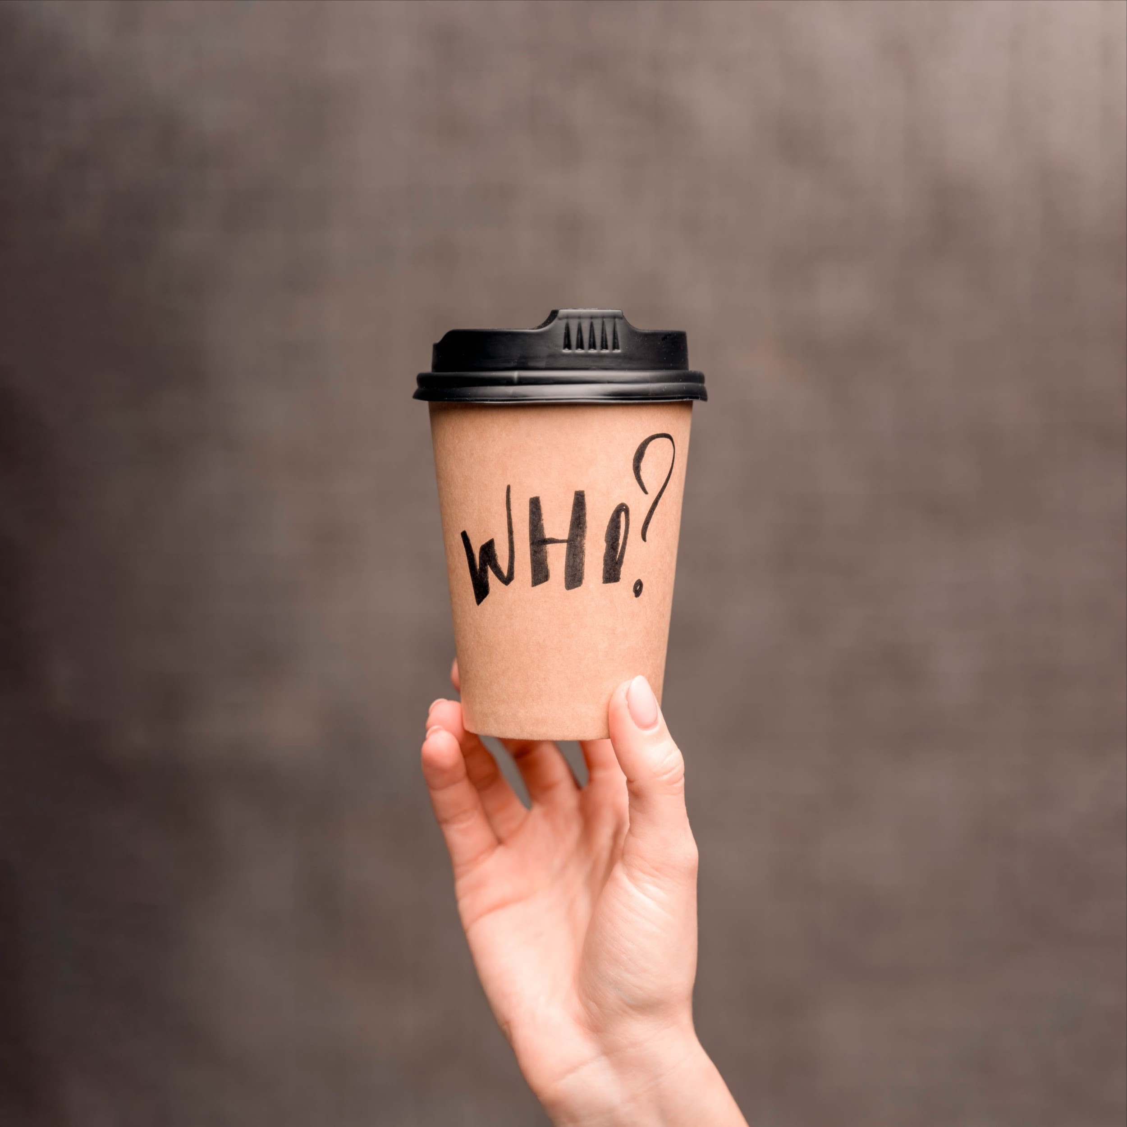
The Perks Of Being a Wallflower by Stephen Chbrosky
Catalina Pacheco 4th grade
Every time I read this book, I cry a lot. Andevery time my mom laughs at me!

Slide 21
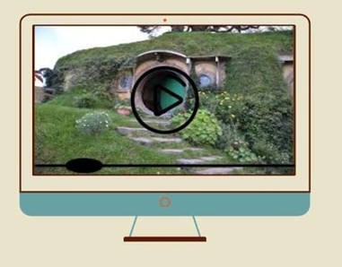
Every time I read or watch “The Lord Of The Rings” and “The hobbit”, I need to keep eating something or I would feel alone.
Benjamin Pino 3MB

Slide 22
Heaven Official’s blessing by Mo Xiang Ton Xiu
When I started reading that novel I loved it so much that I slept between four and five hours a day.
I used to read while going to the bathroom, on the bus and to have lunch!
I finished the book of more 3000 pages in one week.
Time reading
Time sleeping
Ashley Ochoa
4MA

Slide 23
Before I fall
by Ry Ruso-Young
My dad loves tiktok, so he had seen a challenge about “Esperancita” and he tried to do it with me.
Then, he threw a glass of water without looking in my room, and it went right into the book. It was one of my favorites, so we were pretty sad.
He was very sorry at the moment, but now he laughs about it and shows the video to everyone.
Valentina León 3MB

Slide 24
Last year, I read this amazing book called "1984" by George Orwell.
Also, I watched a video about "Animal Farm"
by Orwell.
01
03
I was so in love with dystopic books that I ended up with
new music on my playlist. How crazy is that?!
<1984>
I was so into these narratives that I watched the
movie and read "Brave New World" by Aldous Huxley.
02
04
BENJAMIN ROMERO CIFUENTES 4MA

Slide 25
El Principito
by Antoine de Saint-Exupéry
One day, I went to visit my grandparents and my grandmother told me: “Take this Caro, it is a gift for you”. When I opened it I saw that it was a book called “El Principito” and I was very moved because it reminded me the time when I was a child because I used to watch “El Principito” on discovery kids channel every night.
Carolina Cortés
3rd senior B

Slide 26
Donde Los Árboles Cantan
by Laura Gallegos
I bought this book at the flea market because books from libraries are too expensive for my pocket.
I loved this book!
I read it everywhere, even in classes! Now, I’m considering to save and buy the original version.
Francisca Sagardía 4MA

Slide 27
The Tunnel
Last year, before the pandemic, I was in the "Biblioteca Viva” and I asked for the book "The tunnel“, so then, they lent me the book.
I had this book for one year and I was supposed to give back the next week.
TRINIDAD SANDOVAL DIAZ
3MB

Slide 28
The Little Mermaid By Hans Christian Andersen
I was at my grandmother's house because it was her birthday, and in that house I used to get bored because there was no internet. So I brought a book to read and don't get bored. While reading the book, I wanted to go to the bathroom and when I came back I found my grandmother's dog destroying the book. I was sad because I couldn't read the end of it.
Gabriel Sánchez 2mB

Slide 29
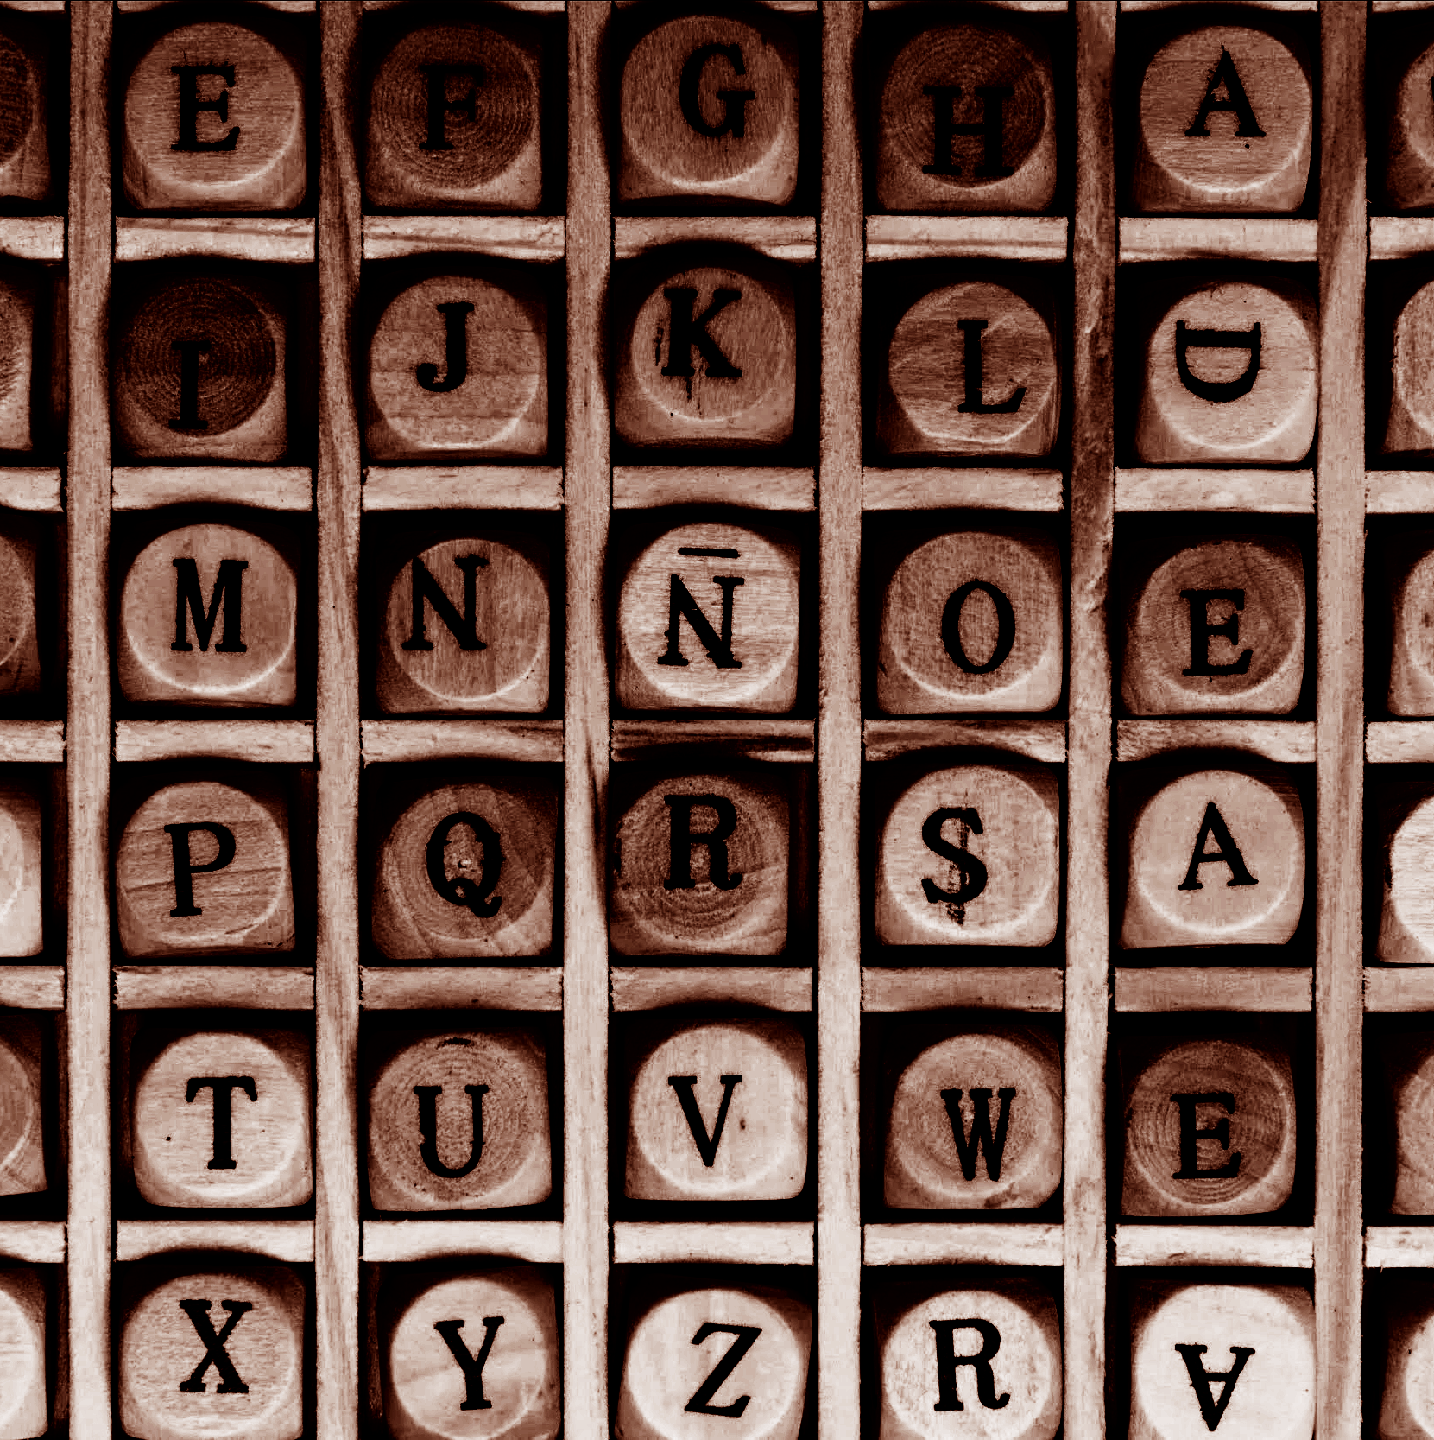
The Book Thief - Markus Zusak
Years ago, I bought this book and a friend asked me to lend it to her.
I said okay because I wasn’t reading it but it took one whole year to get it back!
Yazmin Flores
3MB

